Slide 1





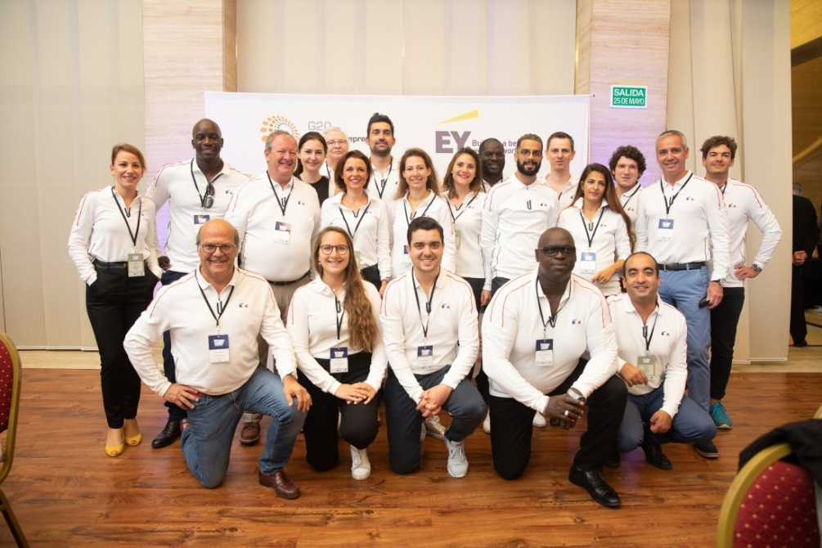



Slide 2


STARTUP
PROGRAMS
ACCELERATION
PROGRAMS
MENTORING
PROGRAMS

Slide 3








